Slide 1

Deep LEARNING In a Nutshell
Stanley Zheng，CUHK

Slide 2
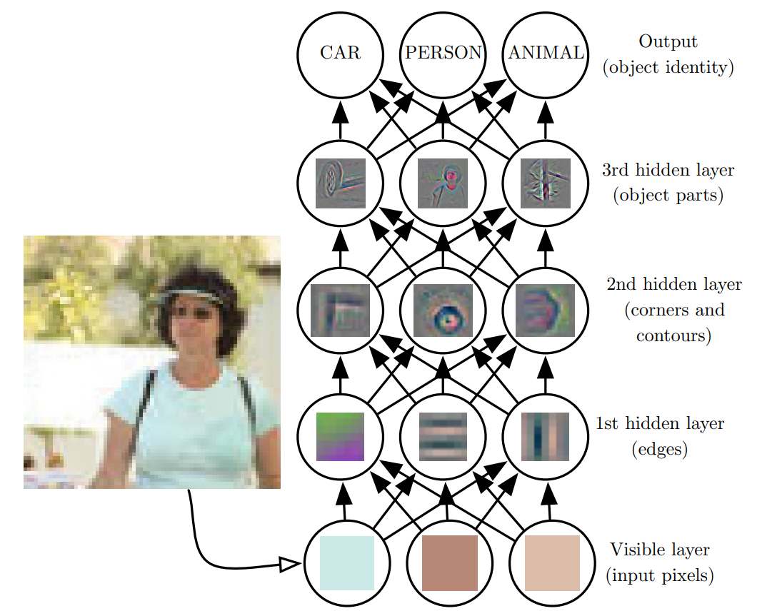
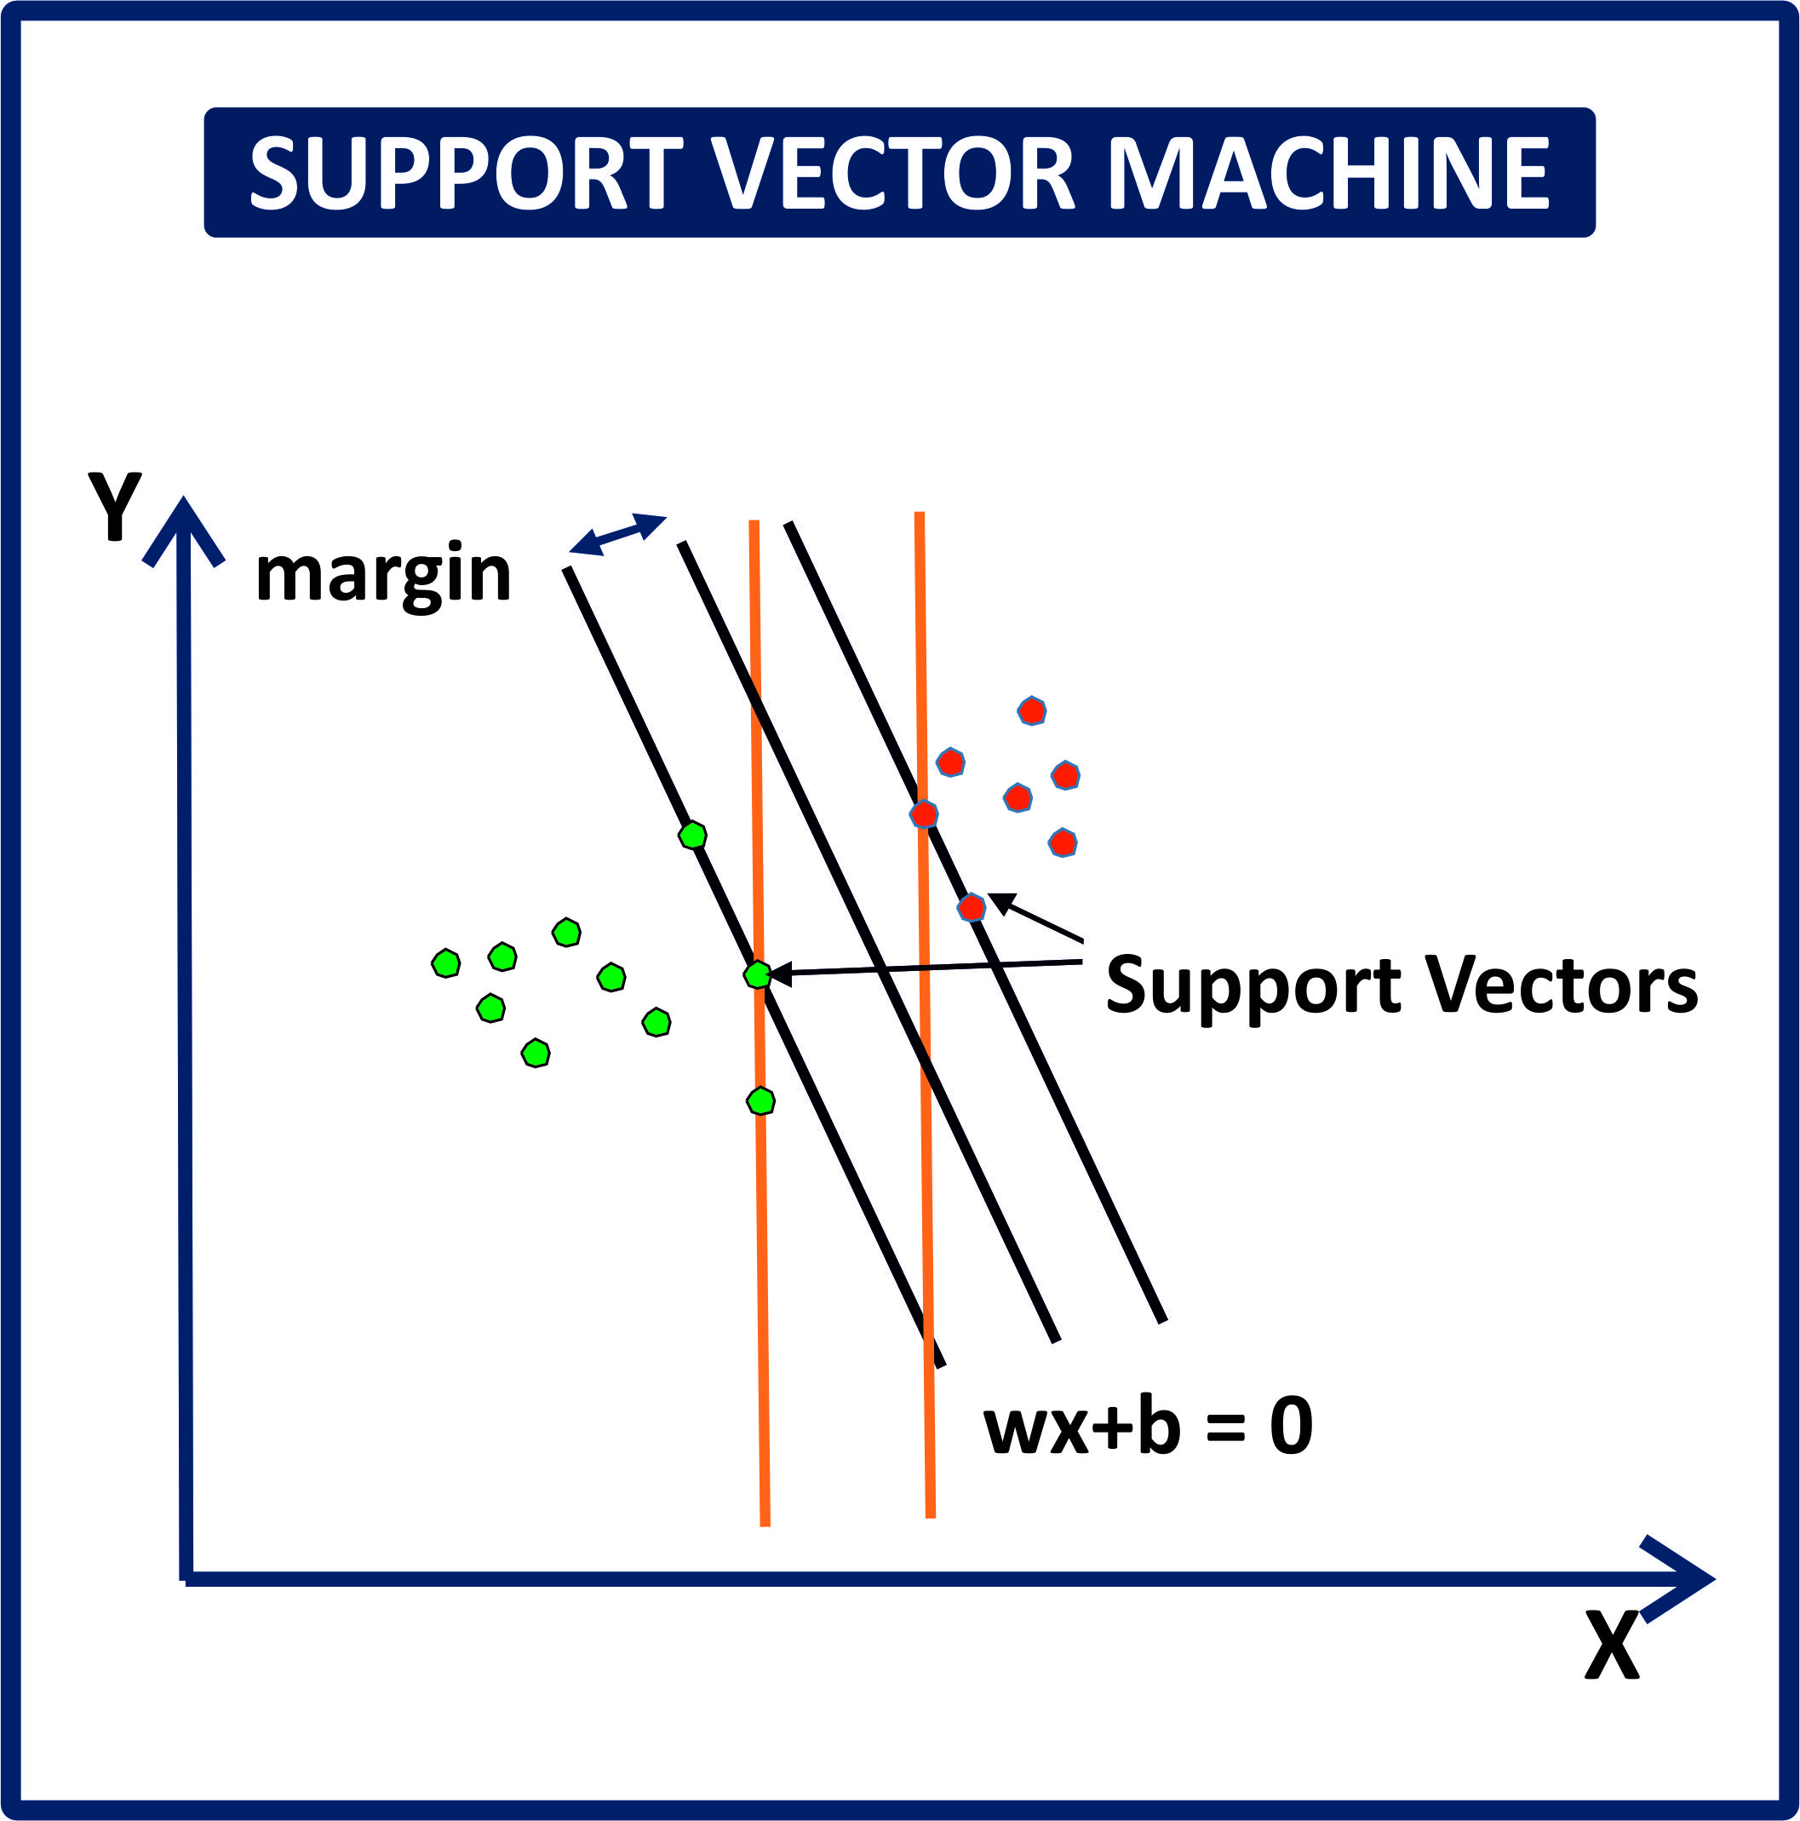
Motivation
Artificial vs. Intelligence

Slide 3
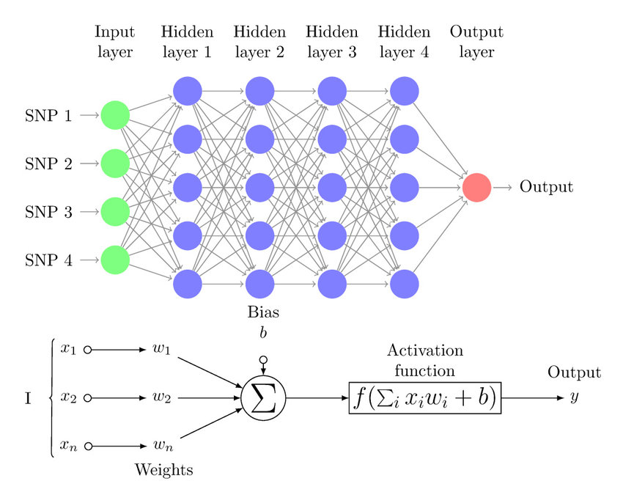

Neuron
Weighted Sum +Activation Function

Slide 4
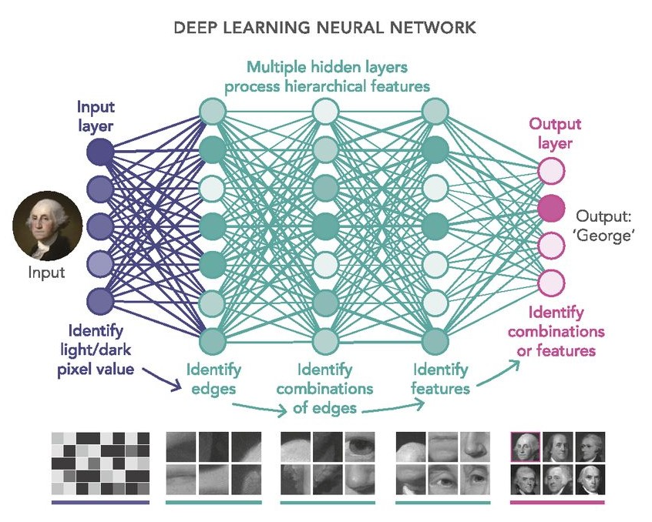
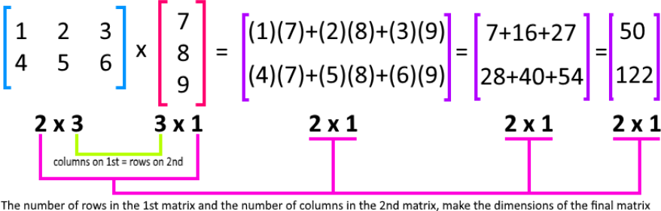
Layer
Fully Connected Layer (or linear layer)
Matrix Multiplication

Slide 5
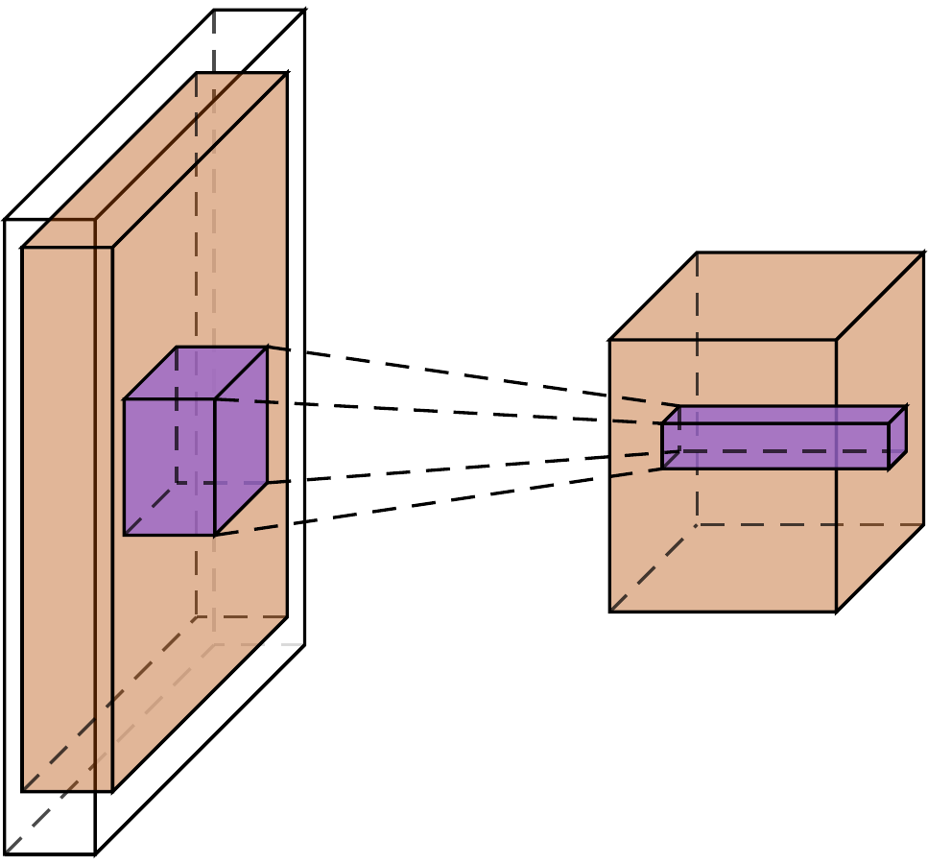

Layer
Ci
Co
Ci
Convolutional Layer
Co
Ho
K
1
1
Hi
Wo
Wi
Input size: [Ci, Hi, Wi]
Output size: [Co, Ho, Wo]
Kernel size: [K, K, Ci, Co]

Slide 6
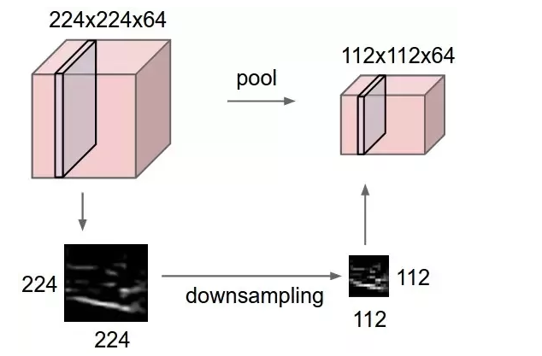

Layer
Max Pooling Layer

Slide 7
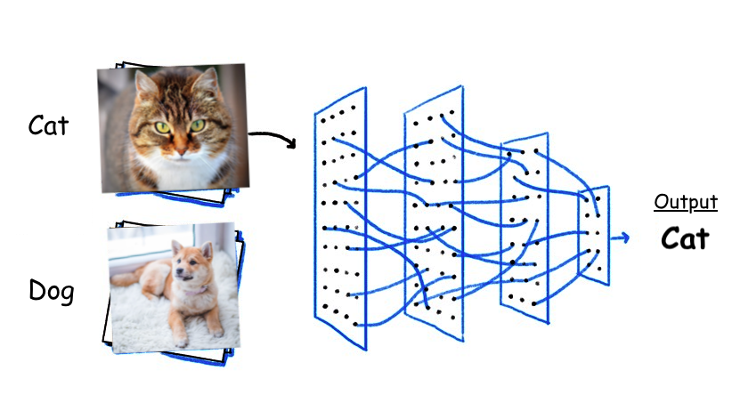
Task
Classification
Input:
RGB: 3 x 224 x 224 (C x H x W)
Output:
One-hot encoding
Cat=[1, 0], Dog=[0, 1]

Slide 8

Network
A Typical Flow

Slide 9
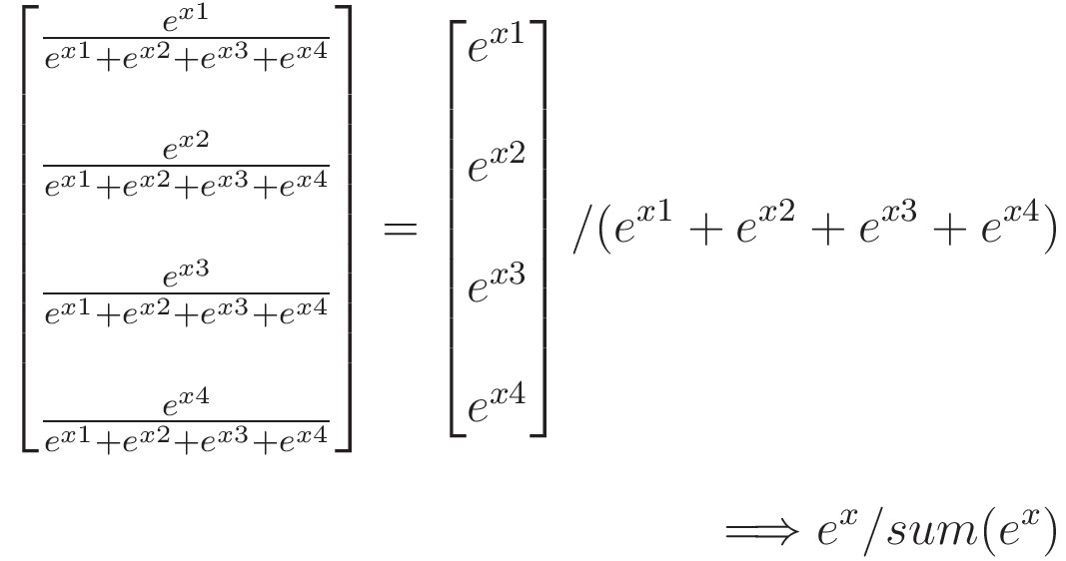
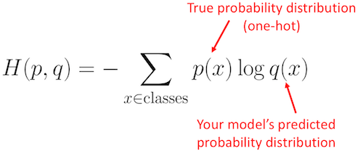
Loss Function
Softmax
Output => Probabilities
Cross Entropy
Comparing labels and predictions
e.g., p=[1, 0], q=[0.8, 0.2] => H=-log(0.8)
e.g., p=[1, 0], q=[0.2, 0.8] => H=-log(0.2)

Slide 10
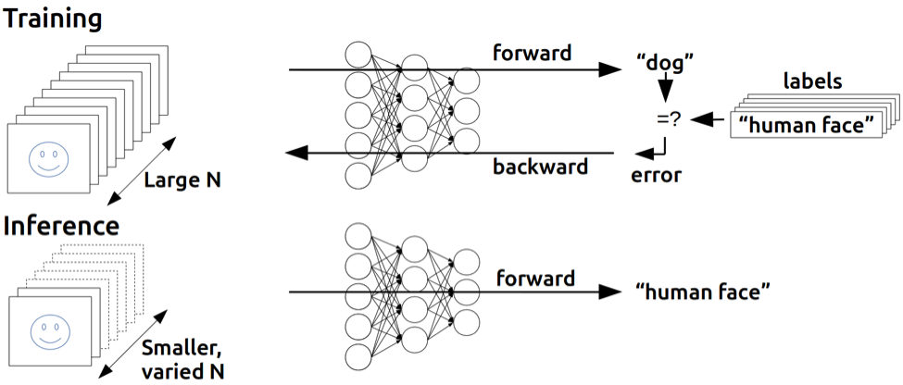
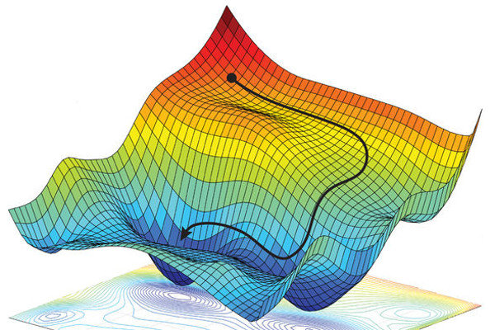
Training
Gradient Descent
Batched data
loss
gradient descent

Slide 11

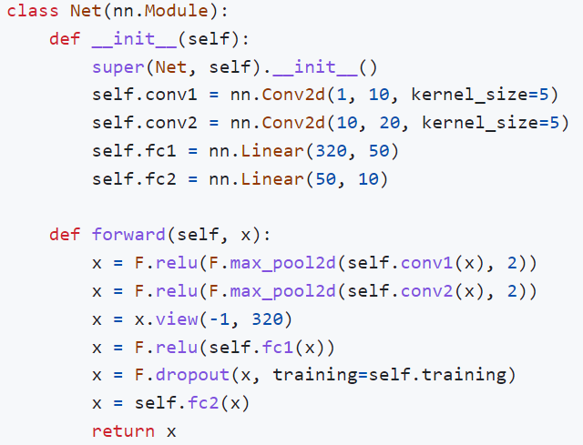
Implementation
MNIST Handwritten Digital Recognition
PyTorch Implementation
Code: https://github.com/shelljane/dl_tutorial

Slide 12
Thanks for Listening
Q & A

